Slide 1

ThroneTalks – Game of Thrones Summarizer

Slide 2
Background & Use Case
Use case: User interaction with the web application
User 1: Game of Thrones Enthusiasts/General Audience
Needs : Rewatch a particular Game of Thrones episode and summary of the previous as a recap
User2 : Discontinued the show for a couple of weeks and now wants to get a recap of all the previous seasons.
Needs : Quick summarization pf season or episodes to quickly understand or catch up on episodes
User 3: Screen writer/Content Creators
Needs : to research on the show to maybe create a similar show/ prequel or sequel using the episode summary generated.
Interaction method: Web application
User Action: The user selects the "season level summary" option and chooses a specific season from a dropdown
list or similar input control.
System Response: The system retrieves and displays a summary of the selected season, including an overview
of the main events, character developments, and any significant changes.
Python libraries – Gradio, Streamlit
Notes:
Background: We are building a text summarizer which
User Action: The user opens the web application.
System Response: The system displays the main interface with two input options: one for selecting a season level summary and another for selecting an episode level summary.
User Action: The user selects the "season level summary" option and chooses a specific season from a dropdown list or similar input control.
System Response: The system retrieves and displays a summary of the selected season, including an overview of the main events, character developments, and any significant changes.
Alternate Path: If the user selects the "episode level summary" option, they are prompted to first choose a season and then a specific episode from that season. System Response: The system retrieves and displays a detailed summary of the chosen episode, highlighting key plot points, character arcs, and critical scenes.

Slide 3
Python Package Choices
Gradio - It is an open-source Python package that allows users to quickly build a demo or web application for your machine learning model, API, or any arbitrary Python function.
Streamlit - Streamlit enables quick transformation of Python scripts into interactive web apps, suitable for building dashboards, generating reports, or creating chat apps, with easy deployment via Community Cloud. It is favored for its simplicity, fast prototyping, live editing, and open-source nature, fostering a vibrant community.
Flask - Flask is a lightweight and flexible Python web application framework that enables the rapid development of simple to complex web applications. It provides developers with tools, libraries, and technologies to build web applications in an easy and efficient manner.
Note: Used for full scale production web applications, but this adds a lot of complexity.
Notes:
Flask: Not for our use case, very very complicated

Slide 4
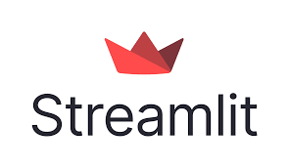

Package Comparison
Parameters | Gradio | Streamlit
Community and Documentation | Growing community Not very extensive documentation as Streamlit. | Widely adopted in the Python community Extensive documentation
Customizations | Gradio offers a set of pre-built components for common use cases, but it is limited as compared to Streamlit. | Streamlit provides more extensive customization options for building highly tailored user interfaces.
Deployment Flexibility | Gradio provides deployment flexibility by allowing users to deploy web applications as either standalone web servers or REST APIs. | Streamlit Community Cloud can be used to deploy the web applications seamlessly and with less effort.
Backend Integration | Gradio's focus is primarily on integrating with machine learning libraries and visualizing model outputs. | Streamlit provides built-in support for common data science libraries such as Pandas, Matplotlib, Seaborn, Plotly, Altair, and many others.
Notes:
Streamlit has a larger community and is more widely adopted in the Python community, making it easier to find resources, tutorials, and community support. It also has extensive documentation that covers a wide range of topics, including best practices and deployment options. Gradio, while it has a growing community, does not have as many resources or extensive documentation as Streamlit.
Streamlit provides more extensive customization options for building highly tailored user interfaces. Users can create custom layouts, add interactive widgets, and style their applications using CSS. Streamlit also offers a wide range of third-party extensions and components for additional functionality. Gradio offers a set of pre-built components for common use cases, but it is limited as compared to Streamlit.
Streamlit Community Cloud can be used to deploy the web applications seamlessly and with less effort. Users can deploy Streamlit applications to various platforms, including cloud services like Heroku, AWS, or Azure, as well as Docker containers or self-hosted servers. Gradio provides deployment flexibility by allowing users to deploy web applications as either standalone web servers or REST APIs.
Streamlit provides built-in support for common data science libraries such as Pandas, Matplotlib, Seaborn, Plotly, Altair, and many others. These libraries can be used seamlessly within Streamlit applications to create interactive visualizations, charts, and plots.. Gradio's focus is primarily on integrating with machine learning libraries and visualizing model outputs. It does not offer as broad a range of integration options like Streamlit

Slide 5
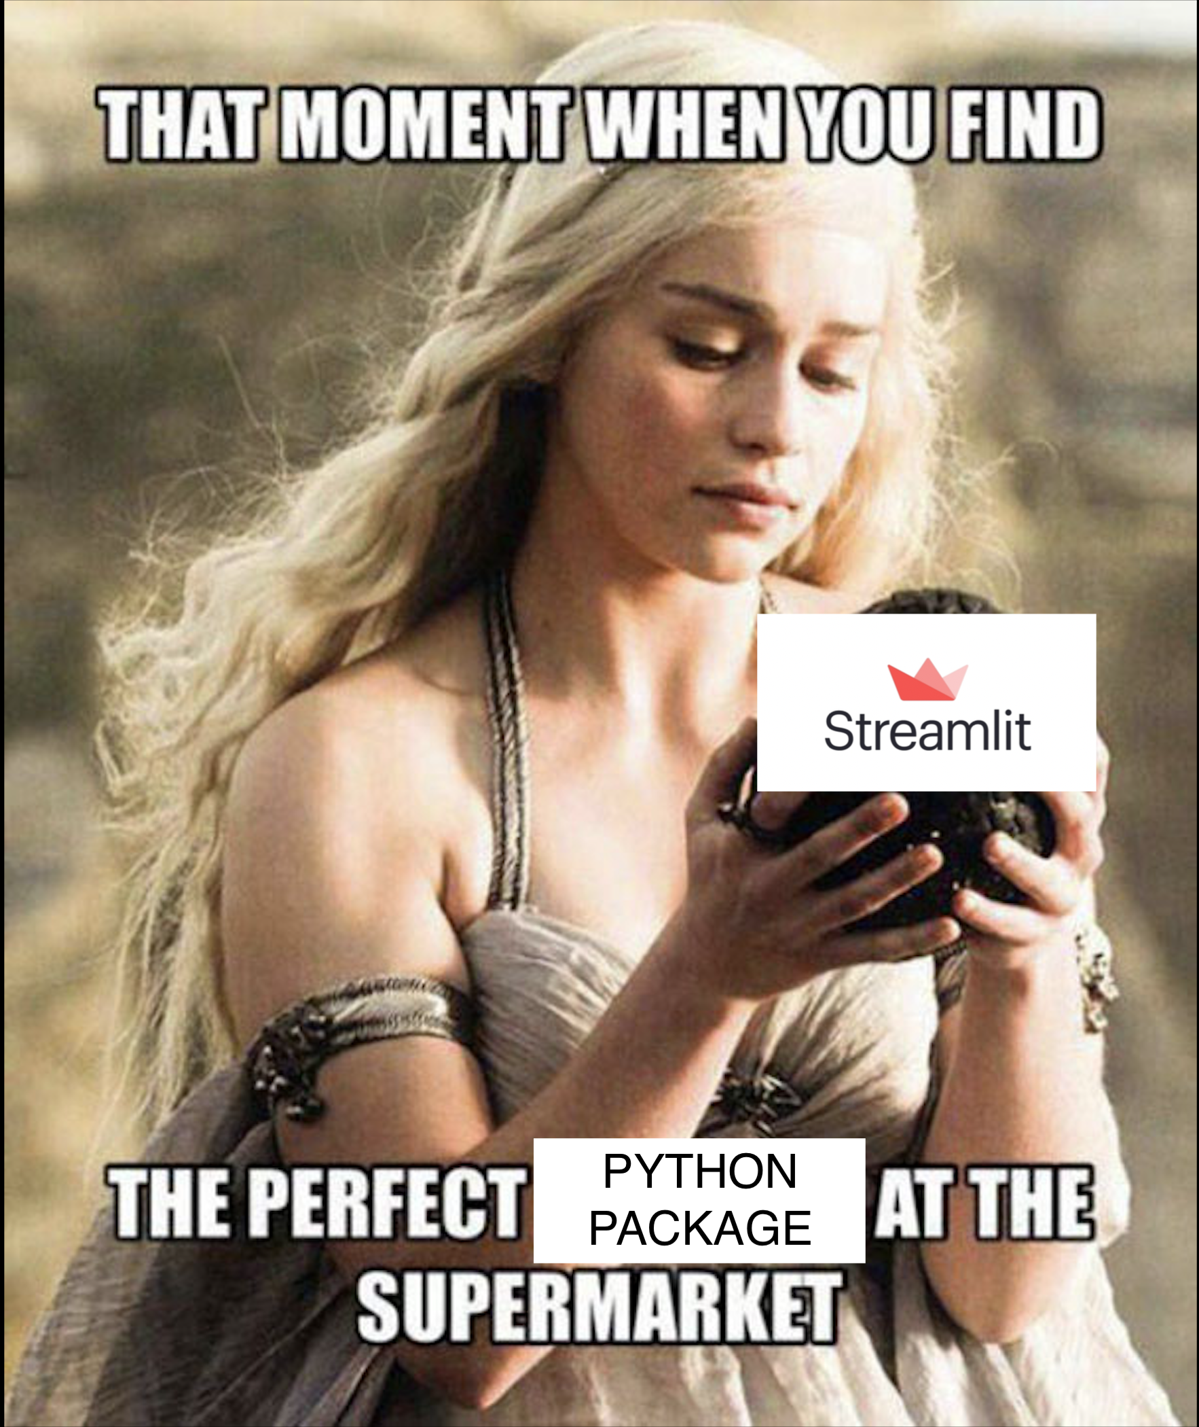

Slide 6
Our Choice
We chose Streamlit for the interface
The primary reason is that being first time users of these library, we wanted good documentation.
Streamlit has a bigger community than Gradio which will help us in getting solutions to issues we will face much easier.
Gradio is primarily a demo tool whereas Stream Lit can be productionized well for small web-applications.
Easy deployment and integrates well with GitHub.
Notes:
Community components for additional customizations.

Slide 7
Drawbacks/Remaining Concerns
Machine learning focus:
Streamlit isn't specifically designed for machine learning models like Gradio is.
Setting up interfaces for complex models might require more work.
Customization complexity:
While offering more customization, it can also be overwhelming for beginners due to its complexity.
This will be our primary concern.
Memory Concerns:
Streamlit community cloud only gives us only 1gb memory for the application to run. If we were to run the model in community cloud we might run out of memory.
We plan to use Azure cloud and use APIs to integrate with the App.

Slide 8
Package Demonstration

